Slide 1

What’s new with ABP 7.0 RC?
Halil İbrahim Kalkan

Slide 2

Overall
Upgraded to .NET 7.0
Upgraded to OpenIddict 4.0
Dapr integration
Integration services
Dynamic features & permissions
External localization system
Distributed entity cache service
Layout hooks for the Blazor UI
Improvements on the eShopOnAbp project

Slide 3
Dapr Integration
Service invocation with C# API Client Proxies integration
Publish & Subscribe with Distributed Event Bus integration
Distributed Lock
Already documented: abp.io/dapr (shortened URL)

Slide 4
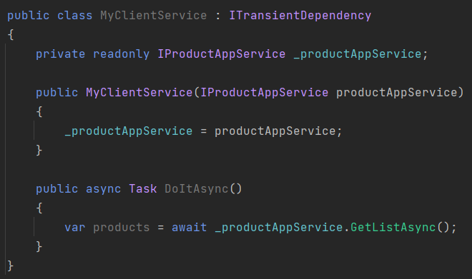
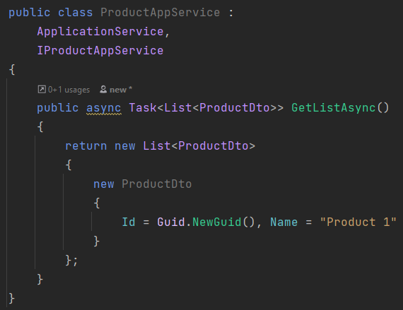
ABP Dynamic C# Client Proxies
.NET Client Application
Server Application
ABP Framework Authentication JSON serialization Exception handling Multi-tenancy
Retry, …. and more

Slide 5
ABP Dynamic C# Client Proxies
.NET Client Application
Server Application
Dapr Sidecar
Dapr Sidecar
ABP Framework Authentication JSON serialization Exception handling Multi-tenancy
Retry, …. and more
Dapr Service discovery Tracing / observability Security
Retry, …. and more

Slide 6

Distributed Event Bus
Microservice A
Microservice B
event
event
ABP Event Bus
Message Broker
(RabbitMQ, Kafka, etc)
ABP Event Bus
application data
application data
re-connect
re-try
publish/subscribe
background workers
auto-events
distributed locking
outbox/inbox
outbox/inbox

Slide 7
Distributed Event Bus
Microservice A
Microservice B
event
event
Dapr Sidecar
Message Broker
(RabbitMQ, Kafka, etc)
Dapr Sidecar
application data
ABP Event Bus
ABP Event Bus
application data
outbox/inbox
outbox/inbox

Slide 8
Integration Services
API Gateway
Product Service
HTTP Requests (external)
UI Application
HTTP Requests (internal)
HTTP Requests (external)
Stock Service
HTTP Requests (external)
3rd-party Clients
HTTP Requests (internal)
HTTP Requests (external)
Ordering Service
HTTP Requests (external)

Slide 9
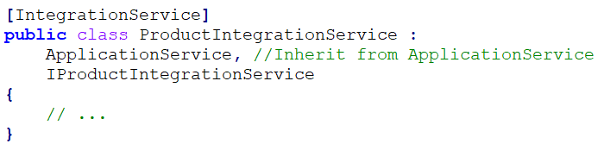
Integration services: How it works?
Introduced the [IntegrationService] attribute
Default HTTP API URL prefix: /integration-api/… instead of /api/…
Audit logging is disabled by default, but can be enabled
Unit of work, Validation, etc. works as expected

Slide 10
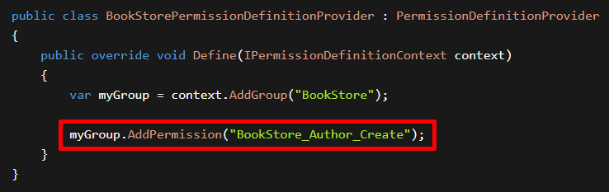
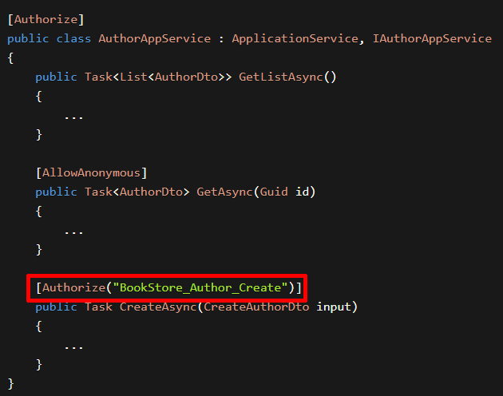
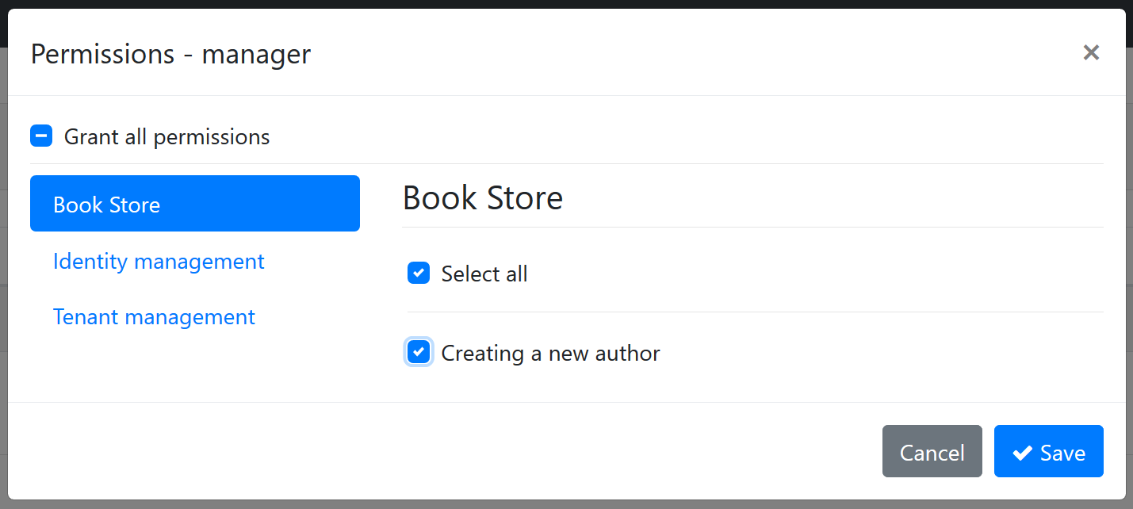
Dynamic Permissions & Features
(1) Define Permissions
(2) Check Permissions
(3) Grant Permissions

Slide 11
Dynamic Permissions & Features
Microservice 1
Permission A, B
Permission Management Database
Microservice 2
Permission C, D, E
The Permission Management UI
Permission Management Microservice
Database Tables AbpPermissionGrants
AbpPermissionGroups AbpPermissions

Slide 12
External Localization System
Auto-sync localization resources defined in all microservices to a shared localization database.
Allow to get and manage localization texts from a single localization service
Introduced the IExternalLocalizationStore service
Optimized localization texts when consumed from clients
Added new APIs to support non-static localization resources

Slide 13
Localization Endpoint Optimization
ABP 6.0: 88.4 kB
ABP 7.0: 42.9 KB (%51.4 shorter)
ApplicationLocalizationScript endpoint can be cached at CDN

Slide 14
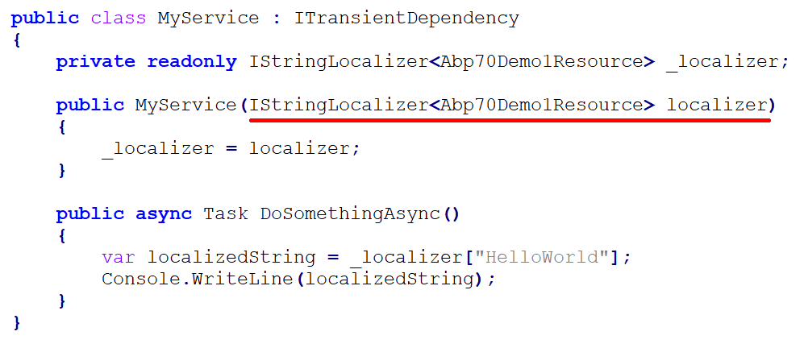
Typed Localization Resources

Slide 15
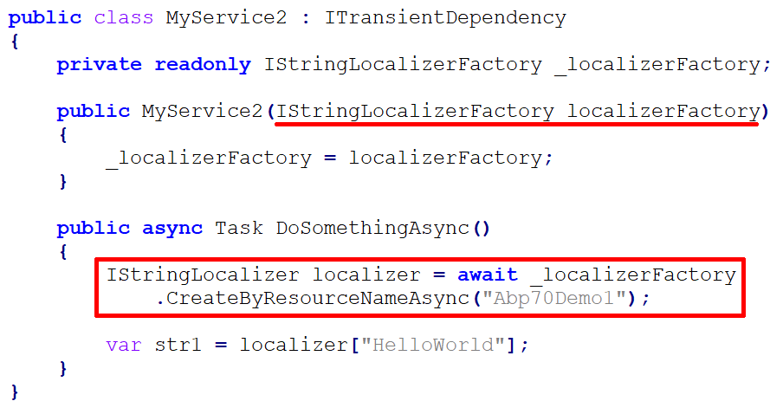
Non-Typed Localization Resources

Slide 16
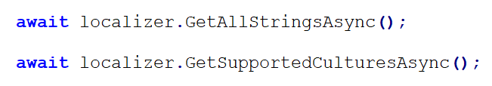
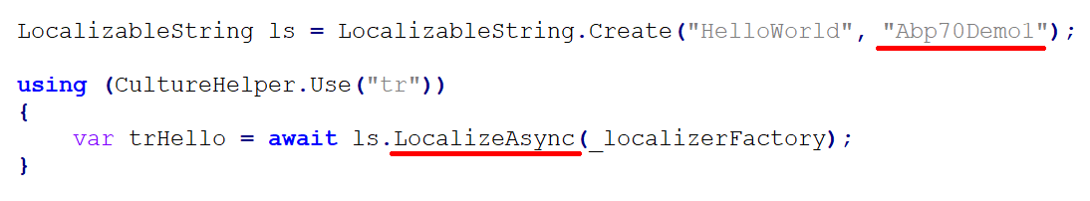
New IStringLocalizer APIs

Slide 17
TODO
Content

Slide 18
TODO
Content

Slide 19
TODO
Content

Slide 20
TODO
Content

Slide 21
TODO
Content

Slide 22
TODO
Content

